Slide 1
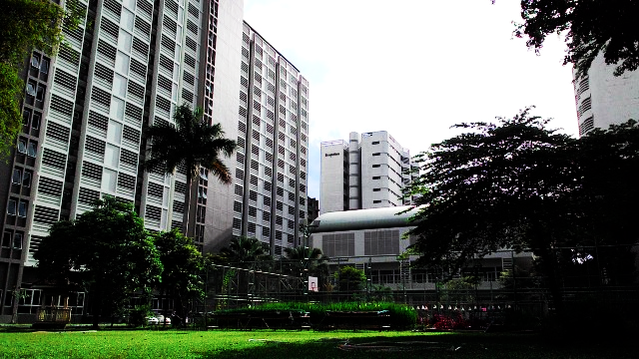
Dormitary Management

Slide 2




Easier for data management and data verification
objective
Decreasing Paper
Reduce time for work

Slide 3


System Function
: Student
: Employee
Check & edit profile
Check activity points
Check a payment result
Send requests
Check a request history
Record dormitory attendance
Check dormitory fees
Check & edit profile
Edit student information
Edit room information
Edit dormitory information
Accept or deny student requests
Create activity
Check & edit student activity

Slide 4
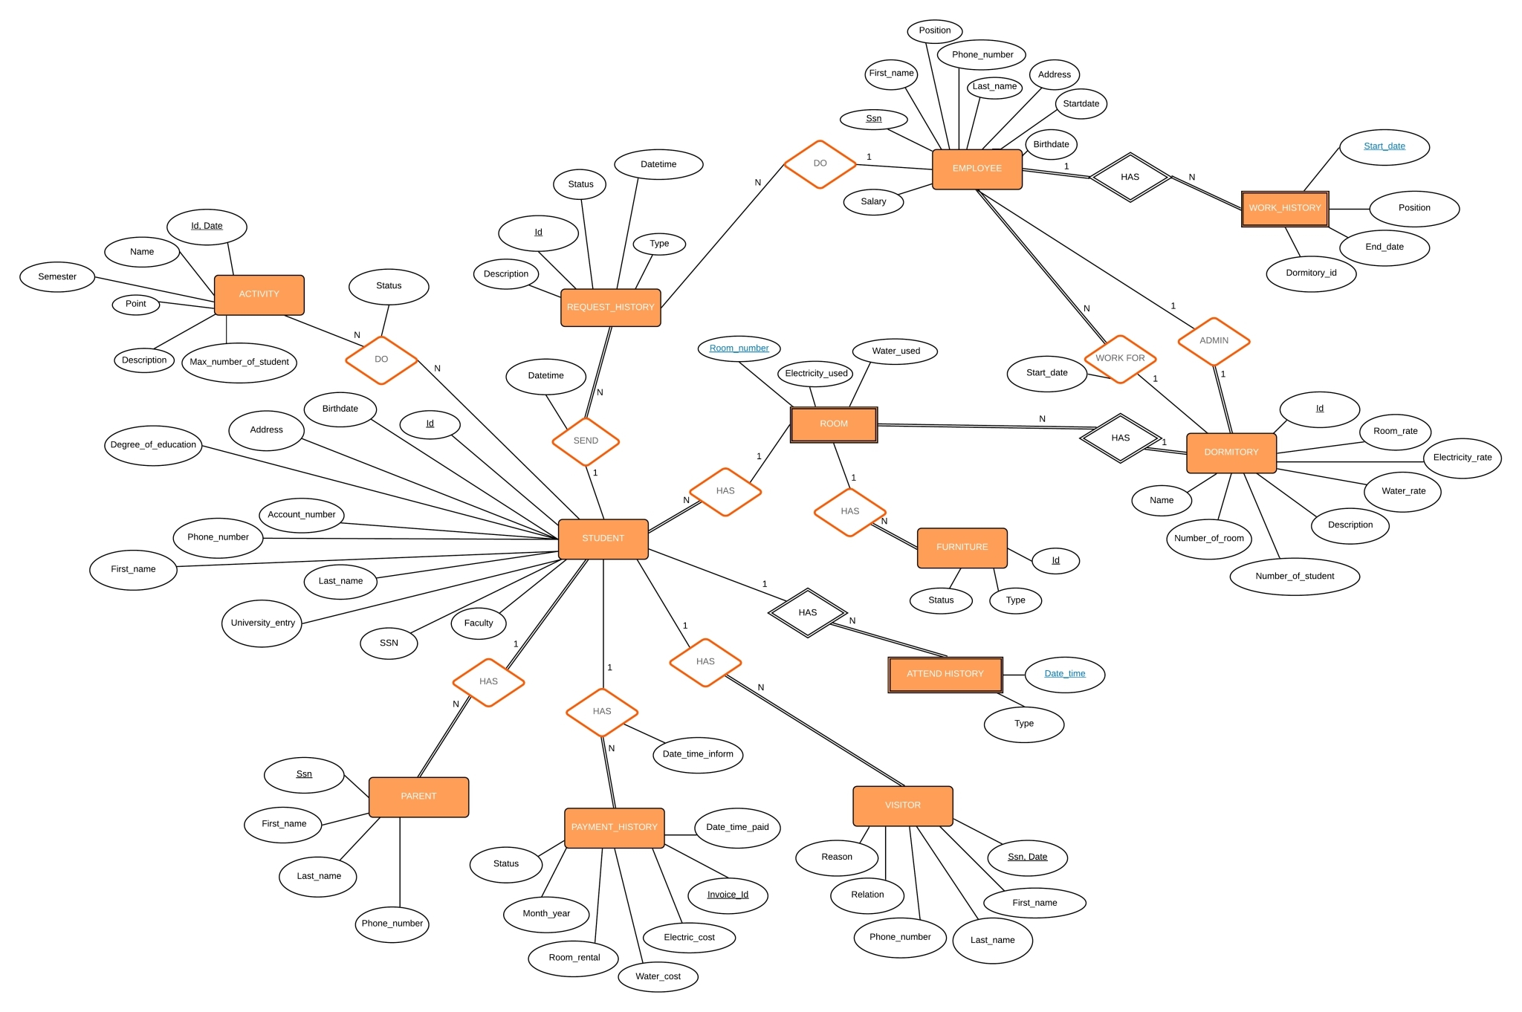

ER Diagram

Slide 5
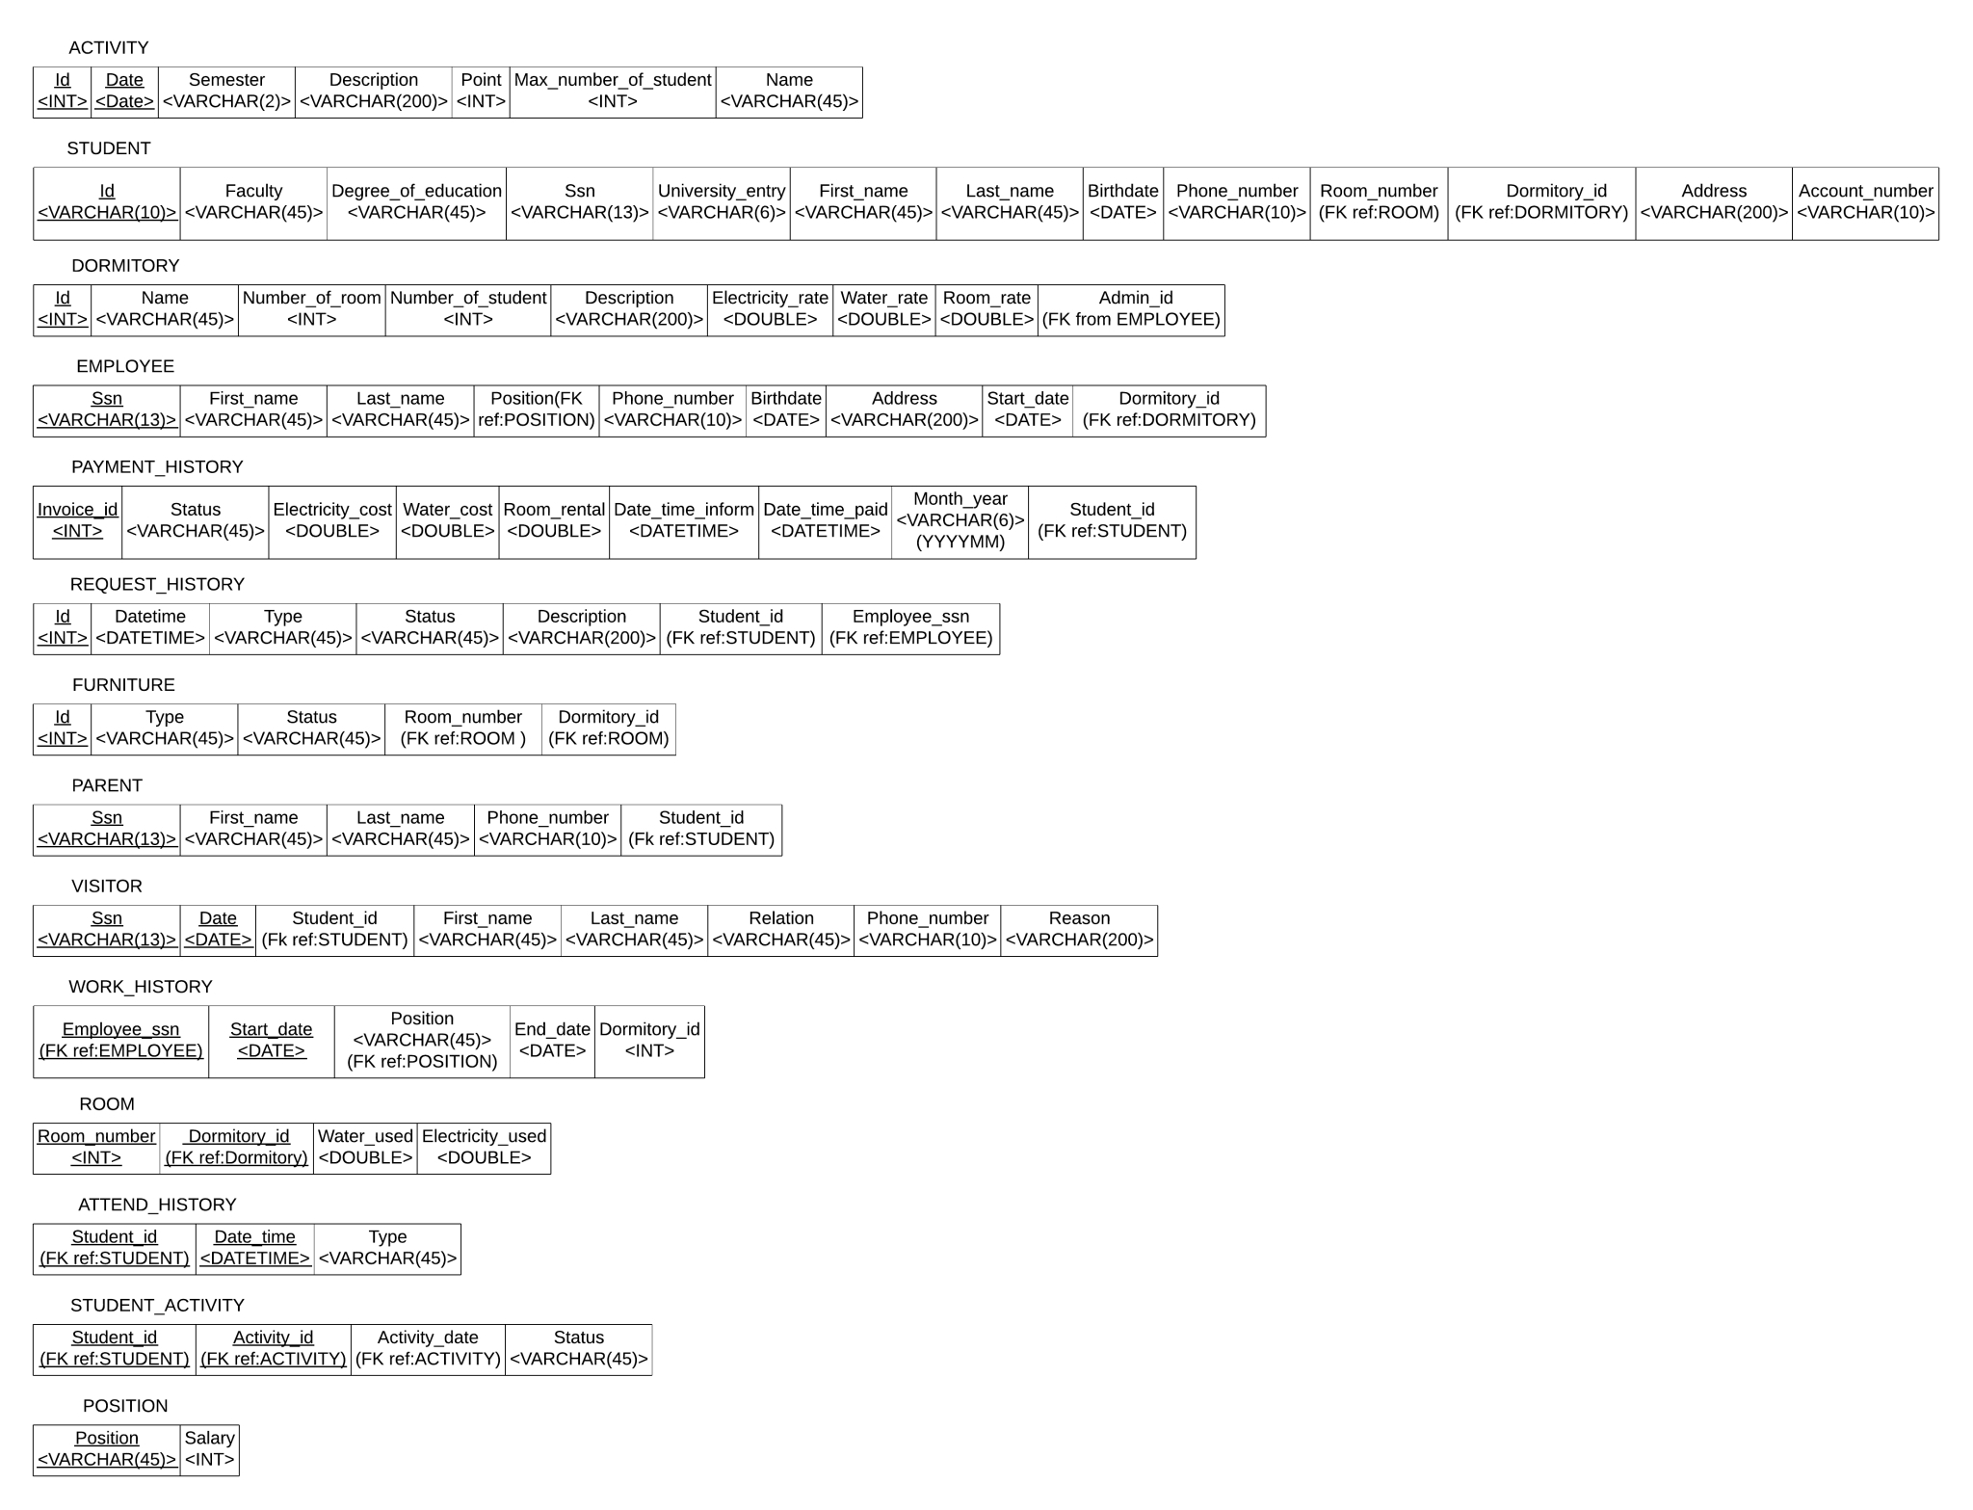

Schema Diagram

Slide 6
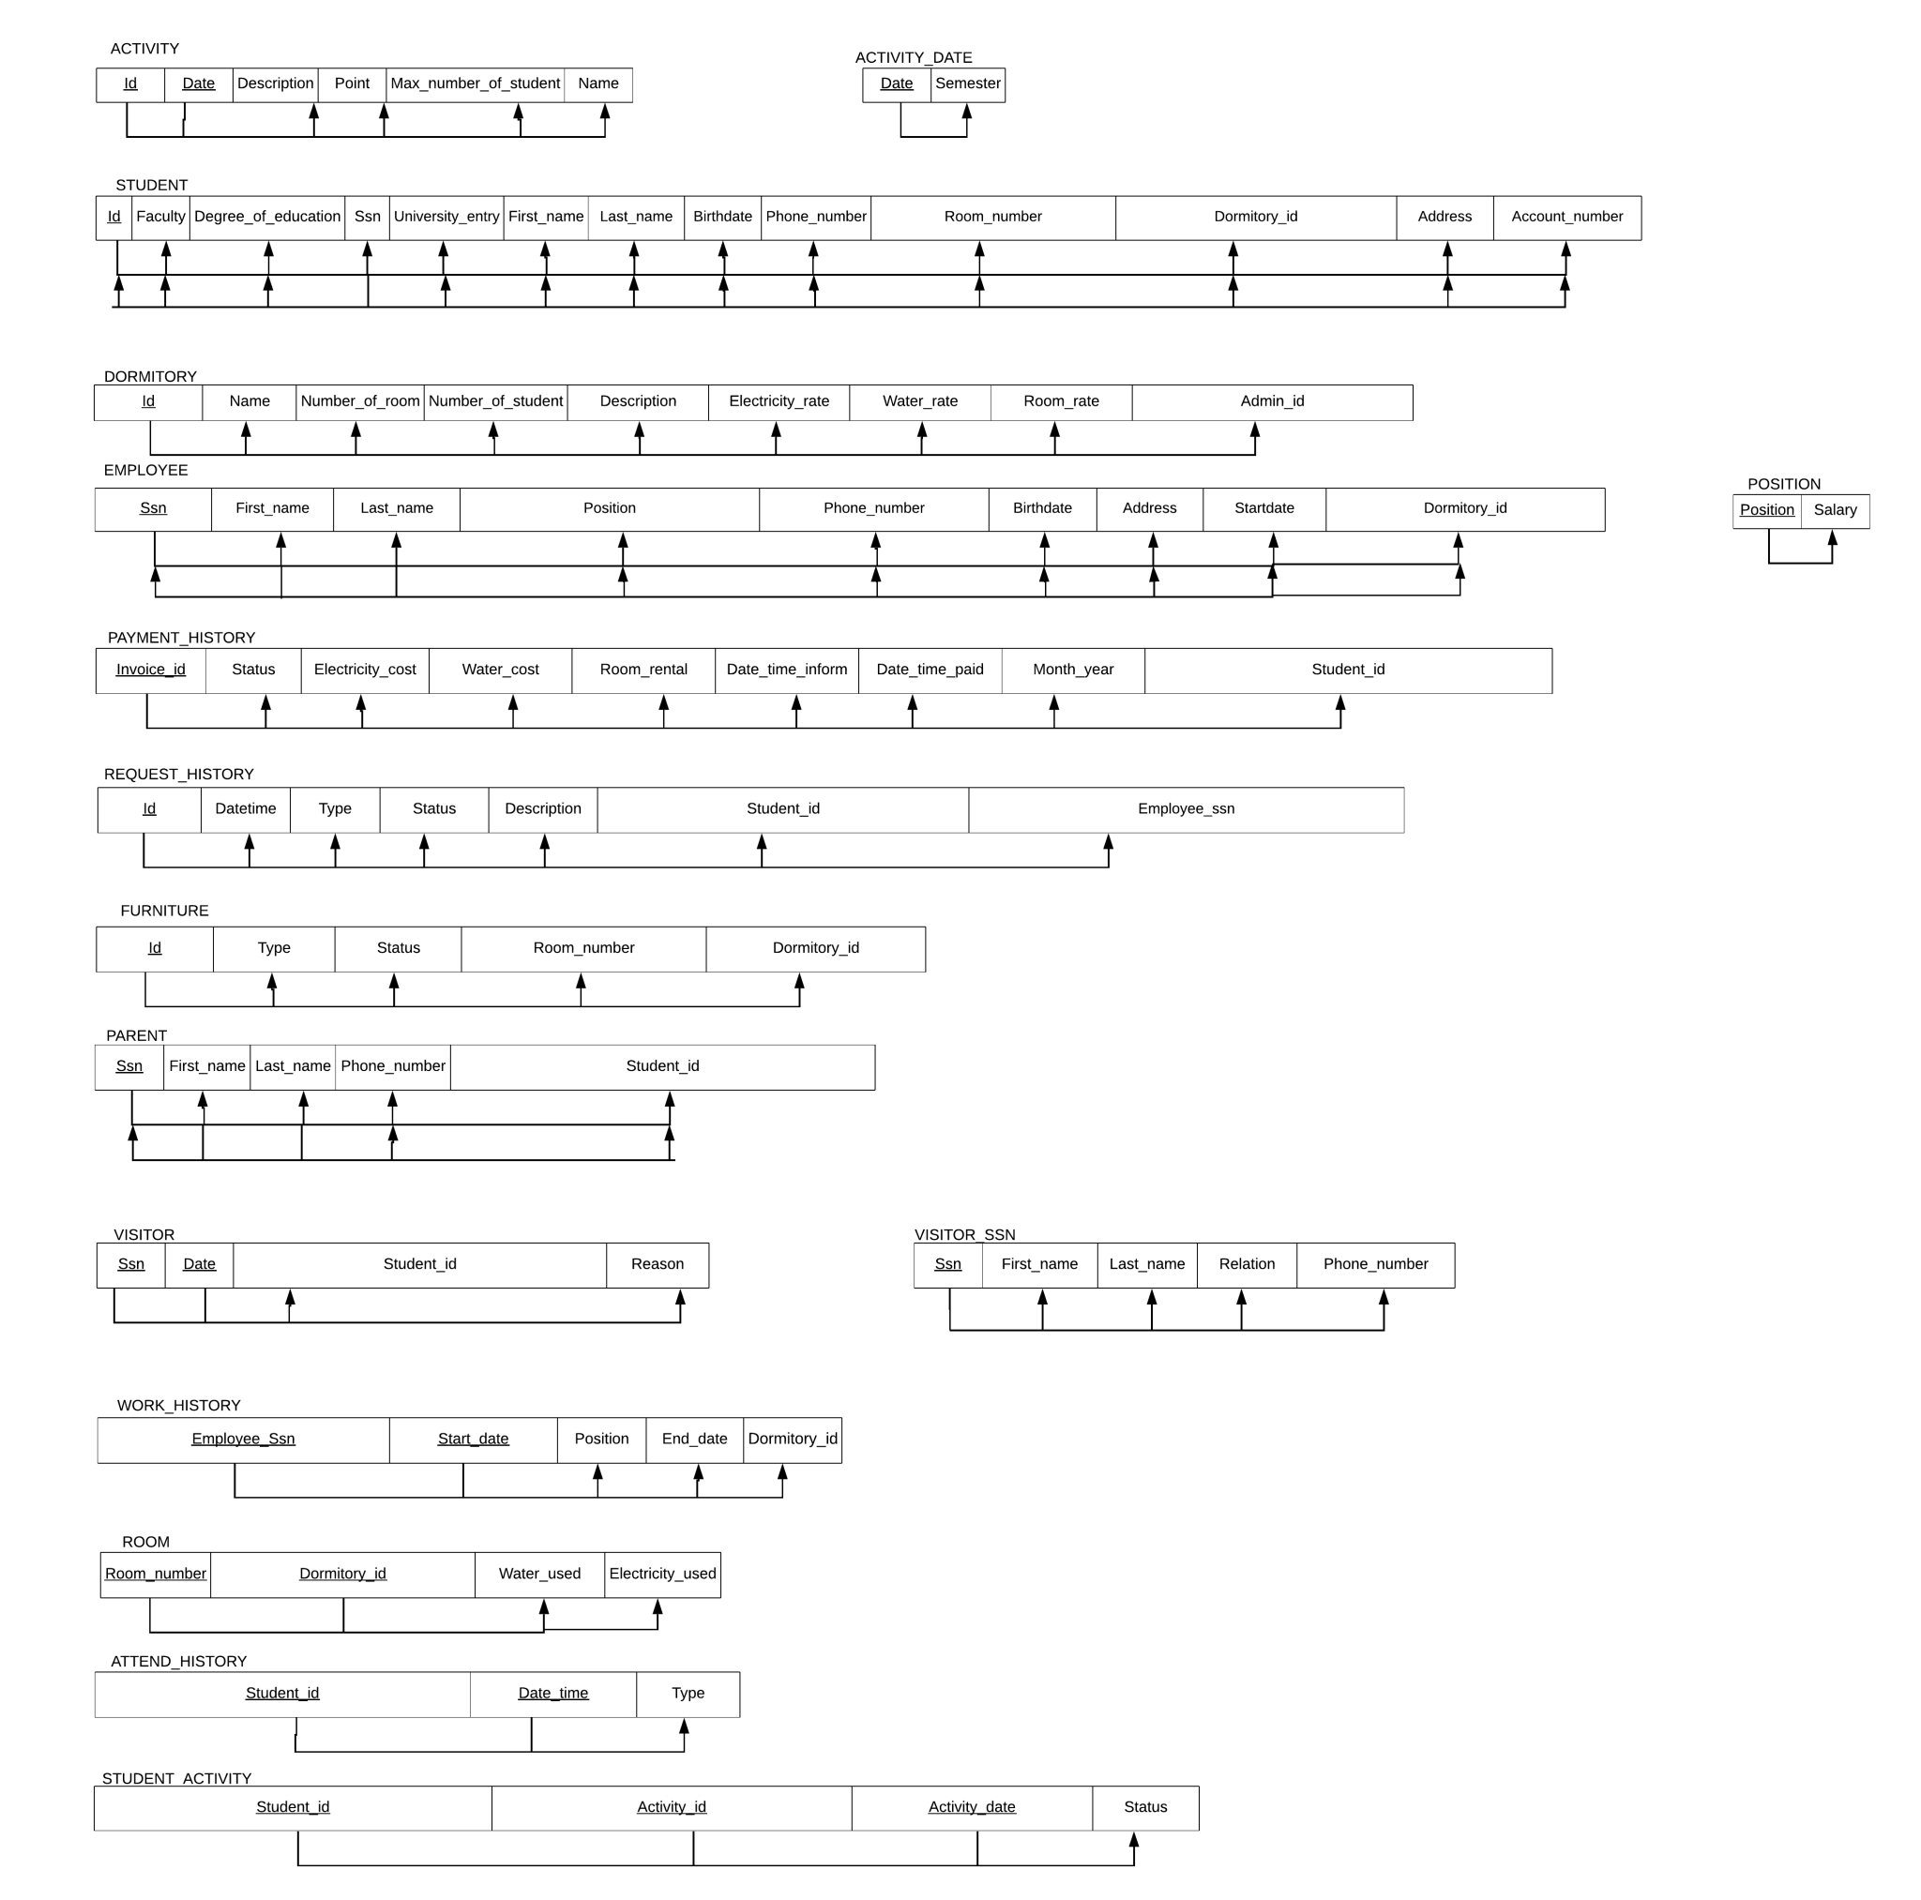

Normalization

Slide 7

DATA DICTIONARY

Slide 8
Attribute Name | Type | Descriptive Name | Valid Values | Allow Nulls
Id | INT | Dormitory id | Number(5) | NO
Name | VARCHAR(45) | Dormitory’s name |  | NO
Number_of_room | INT | Number of room in dormitory | Number > 0 | NO
Number_of_student | INT | Number of student in the dormitory | Number >= 0 | NO
Description | VARCHAR(200) | Dormitory description |  | YES
Electricity_rate | DOUBLE | Electricity charge per unit | Number > 0 | NO
Water_rate | DOUBLE | Water charge per unit | Number > 0 | NO
Room_rate | INT | room rental | Number > 0 | NO
Admin_id (FK ref: EMPLOYEE) | VARCHAR(13) | Dormitory’s admin id | Number(13) | NO
Table Name: DORMITORY

Slide 9
Table Name: ROOM
Attribute Name | Type | Descriptive Name | Valid Values | Allow Nulls
Room_number | INT | Room id | Number(5) | NO
Electricity_used | DOUBLE | Electricity charge unit used | Number >= 0 | NO
Water_used | DOUBLE | Water charge unit used | Number >= 0 | NO
Dormitory_id (FK ref: DORMITORY) | VARCHAR(5) | Dormitory id | Number(5) | NO
Attribute Name | Type | Descriptive Name | Valid Values | Allow Nulls
Id | INT | Furniture id | Number(5) | NO
Type | VARCHAR(45) | Furniture type |  | NO
Status | VARCHAR(45) | Furniture status |  | NO
Room_number (FK ref: ROOM) | INT | Room id | Number(5) | NO
Dormitory_id (FK ref : ROOM) | INT | Dormitory id | Number(5) | NO
Table Name: Furniture

Slide 10
Attribute Name | Type | Descriptive Name | Valid Values | Allow Nulls
Id | VARCHAR(10) | Student id | Number(10) | NO
Ssn | VARCHAR(13) | Ssn of Student | Number(13) | NO
Faculty | VARCHAR(45) | Faculty |  | NO
Degree_of_education | VARCHAR(45) | Degree of education |  | NO
University_entry | VARCHAR(6) | Semester/year that student entries the university | T-YYYY | NO
First_name | VARCHAR(45) | First name |  | NO
Last_name | VARCHAR(45) | Last name |  | NO
Birthdate | DATE | Birthdate | DD-MM-YYYY | NO
Phone_number | VARCHAR(10) | Phone number | Number(10) | NO
Table Name:
STUDENT

Slide 11
Table Name: STUDENT
(continue)
Attribute Name | Type | Descriptive Name | Valid Values | Allow Nulls
Address | VARCHAR(200) | Student’s Address |  | NO
Account_number | VARCHAR(10) | Student’s Account | NUMBER(10) | NO
Room_number (FK ref : ROOM) | INT | Room id | Number(5) | NO
Dormitory_id (FK ref : DORMITORY) | INT | dormitory id | Number(5) | NO
Attribute Name | Type | Descriptive Name | Valid Values | Allow Nulls
Date_time | DATETIME | Date that student attend to dormitory | DD-MM-YYYY | NO
Type | VARCHAR(45) | Type of attendance | IN/OUT | NO
Student_id (FK ref : STUDENT) | VARCHAR(10) | Student id | Number(10) | NO
Table Name: ATTEND_HISTORY

Slide 12
Attribute Name | Type | Descriptive Name | Valid Values | Allow Nulls
Ssn | VARCHAR(13) | Ssn of Visitor | Number(13) | NO
First_name | VARCHAR(45) | Visitor’s first name |  | NO
Last_name | VARCHAR(45) | Visitor’s last name |  | NO
Phone_number | VARCHAR(10) | Visitor’s phone number | Number(10) | NO
Relation | VARCHAR(45) | Relation between visitor and student |  | NO
Date | DATE | Visitor entrance date | DD-MM-YYYY | NO
Reason | VARCHAR(200) | reason of visitor that want to visit dormitory |  | NO
Student_id(FK ref : STUDENT) | VARCHAR(10) | Student id of student who has relation with visitor | Number(10) | NO
Table Name:
VISITOR

Slide 13
Attribute Name | Type | Descriptive Name | Valid Values | Allow Nulls
Invoice_id | INT | Invoive id |  | NO
Status | VARCHAR(45) | Payment status | NOT PAID/ PAID | NO
Electricity_cost | DOUBLE | electric charge | Number > 0 | NO
Water_cost | DOUBLE | water charge | Number > 0 | NO
Room_rental | DOUBLE | Room rental | Number > 0 | NO
Date_time_inform | DATETIME | Date that student has been informed | YYYY-MM-DD 00:00:000 | NO
Date_time_paid | DATETIME | Date that student make a payment | YYYY-MM-DD 00:00:000 | YES
Month_year | VARCHAR(6) | Month & year of invoice | YYYYMM | NO
Student_id (FK ref : STUDENT) | VARCHAR(10) | Student id | Number(10) | NO
Table Name:
PAYMENT_HISTORY

Slide 14
Table Name: PARENT
Attribute Name | Type | Descriptive Name | Valid Values | Allow Nulls
Ssn | VARCHAR(13) | Ssn of Parent | Number(13) | NO
First_name | VARCHAR(45) | Parent’s first name |  | NO
Last_name | VARCHAR(45) | Parent’s last name |  | NO
Phone_number | VARCHAR(10) | Parent’s phone number | Number(10) | NO
Student_id (FK ref : STUDENT) | VARCHAR(10) | Student id | Number(10) | NO
Attribute Name | Type | Descriptive Name | Valid Values | Allow Nulls
Status | VARCHAR(45) | Activity status |  | NO
Student_id (FK ref: STUDENT) | VARCHAR(10) | Student id | Number(10) | NO
Activity_id (FK ref : ACTIVITY) | INT | Activity id | Number(5) | NO
Activity_date (FK ref : ACTIVITY) | DATE | Activity start date | DD-MM-YYYY | NO
Table Name: STUDENT_ACTIVITY

Slide 15
Attribute Name | Type | Descriptive Name | Valid Values | Allow Nulls
Id | INT | Activity id | Number(5) | NO
Name | VARCHAR(45) | Activity’s name |  | NO
Date | DATE | Activity’s start date | DD-MM-YYYY | NO
Description | VARCHAR(200) | Activity information |  | YES
Point | INT | Activity point | Number > 0 | NO
Max_number_of_student | INT | Max number of student for the activity | Number > 0 | NO
Semester | VARCHAR(2) | semester | Number(2) | NO
Table Name:
ACTIVITY

Slide 16
Attribute Name | Type | Descriptive Name | Valid Values | Allow Nulls
Ssn | VARCHAR(13) | Ssn of Employee | Number(13) | NO
First_name | VARCHAR(45) | Employee’s first name |  | NO
Last_name | VARCHAR(45) | Employee’s last name |  | NO
Phone_number | VARCHAR(10) | Employee’s phone number | Number(10) | NO
Birthdate | DATE | Employee’s birth date | DD-MM-YYYY | NO
Address | VARCHAR(200) | Employee’s address |  | NO
Startdate | DATE | Date that employee start to work | DD-MM-YYYY | NO
Position | VARCHAR(45) | position of employee |  | NO
Salary | INT | Employee’s salary | Number >=0 | NO
Dormitory_id (FK ref: DORMITORY) | INT | Dormitory id | Number(5) | NO
Table Name:
EMPLOYEE

Slide 17
Attribute Name | Type | Descriptive Name | Valid Values | Allow Nulls
Id | INT | Request id | Positive integer | NO
Datetime | DATETIME | Date that sending the request | DD-MM-YYYY 00:00:000 | NO
Type | VARCHAR(45) | Type of request |  | NO
Description | VARCHAR(200) | Request’s description |  | YES
Status | VARCHAR(45) | Request status | SENT RECEIVED IN_PROGRESS COMPLETE | NO
Student_id (FK ref : STUDENT) | VARCHAR(10) | Student id | Number(10) | NO
Employee_Ssn (FK ref:EMPLOYEE) | VARCHAR(13) |  | Number(13) | YES
Table Name:
REQUEST_HISTORY

Slide 18

Table Name: WORK_HISTORY
Attribute Name | Type | Descriptive Name | Valid Values | Allow Nulls
Start_date | DATE | Employee’s start date | DD-MM-YYYY | NO
Position | VARCHAR(45) | Position of employee |  | NO
End_date | DATE | The last date that employee is in the position | DD-MM-YYYY | YES
Dormitory_id | VARCHAR(5) | Dormitory id | Number(5) | NO
Employee_SsN (FK ref: EMPLOYEE) | VARCHAR(13) | Ssn of Employee | Number(13) | NO
Data dictionary

Slide 19

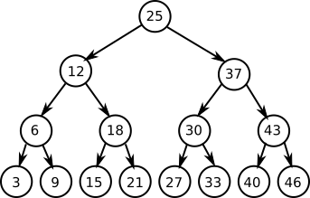
INDEXING
Relation : EMPLOYEE
Attribute : Dormitory_id Index structure : B TREE indexes

Slide 20

Why B plus tree ???
InnoDB utilizes hash indexes internally for its Adaptive Hash Index feature.
it magically determines when it is worth supplementing InnoDB B-Tree-based indexes with fast hash lookup tables and then builds them automatically without a prompt from the user.
Ref: https://www.percona.com/blog/2016/04/12/is-adaptive-hash-index-in-innodb-right-for-my-workload/
https://dev.mysql.com/doc/refman/8.0/en/storage-engines.html

